Slide 1
Opportunities To Change The Outcomes Of Traumatized Children 2015

Slide 2
CAN Contributors

Slide 3
Childhood Adversity Narratives

Slide 5
There is No Single “Best” Term

Slide 6
ACES (Adverse Childhood Experiences)¹

Slide 7
ACES Prevalence (%) of Abuse and Neglect In the Original Study¹

Slide 8
ACES Prevalence (%) of Household Dysfunction In the Original Study¹

Slide 9
Percent of Cumulative Adverse Childhood Experiences ACES in the Original Study¹

Slide 11
Rates of Maltreatment by Age¹

Slide 13
How ACES Cross Generations

Slide 18
Impact of Cumulative ACES & Social Dysfunction¹

Slide 19
Implications of Cumulative ACES

Slide 20
Synergy

Slide 21
Synergistic ACES Increase Complex Adult Psychopathology¹

Slide 22
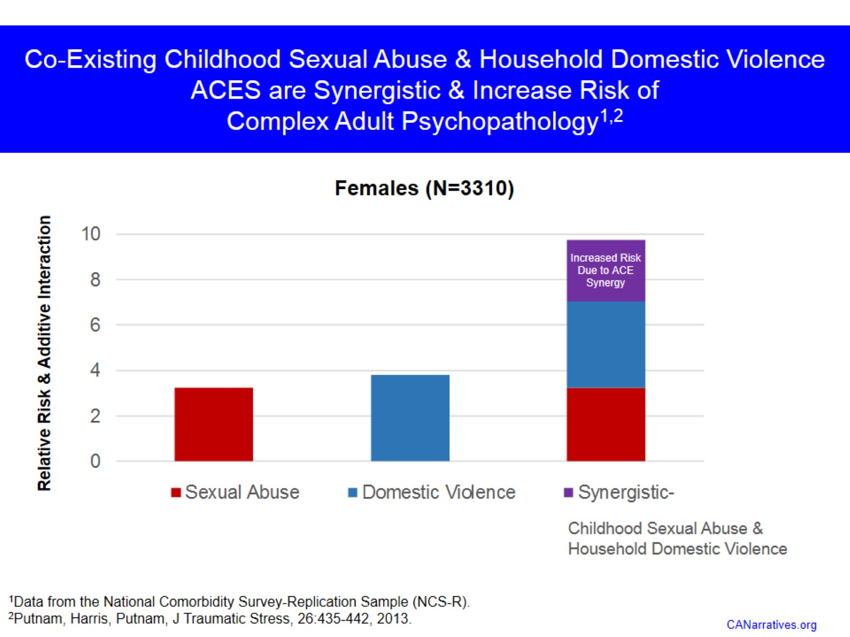
Co-Existing Childhood Sexual Abuse & Household Domestic Violence ACES are Synergistic & Increase Risk of Complex Adult Psychopathology^{1,2}

Slide 23
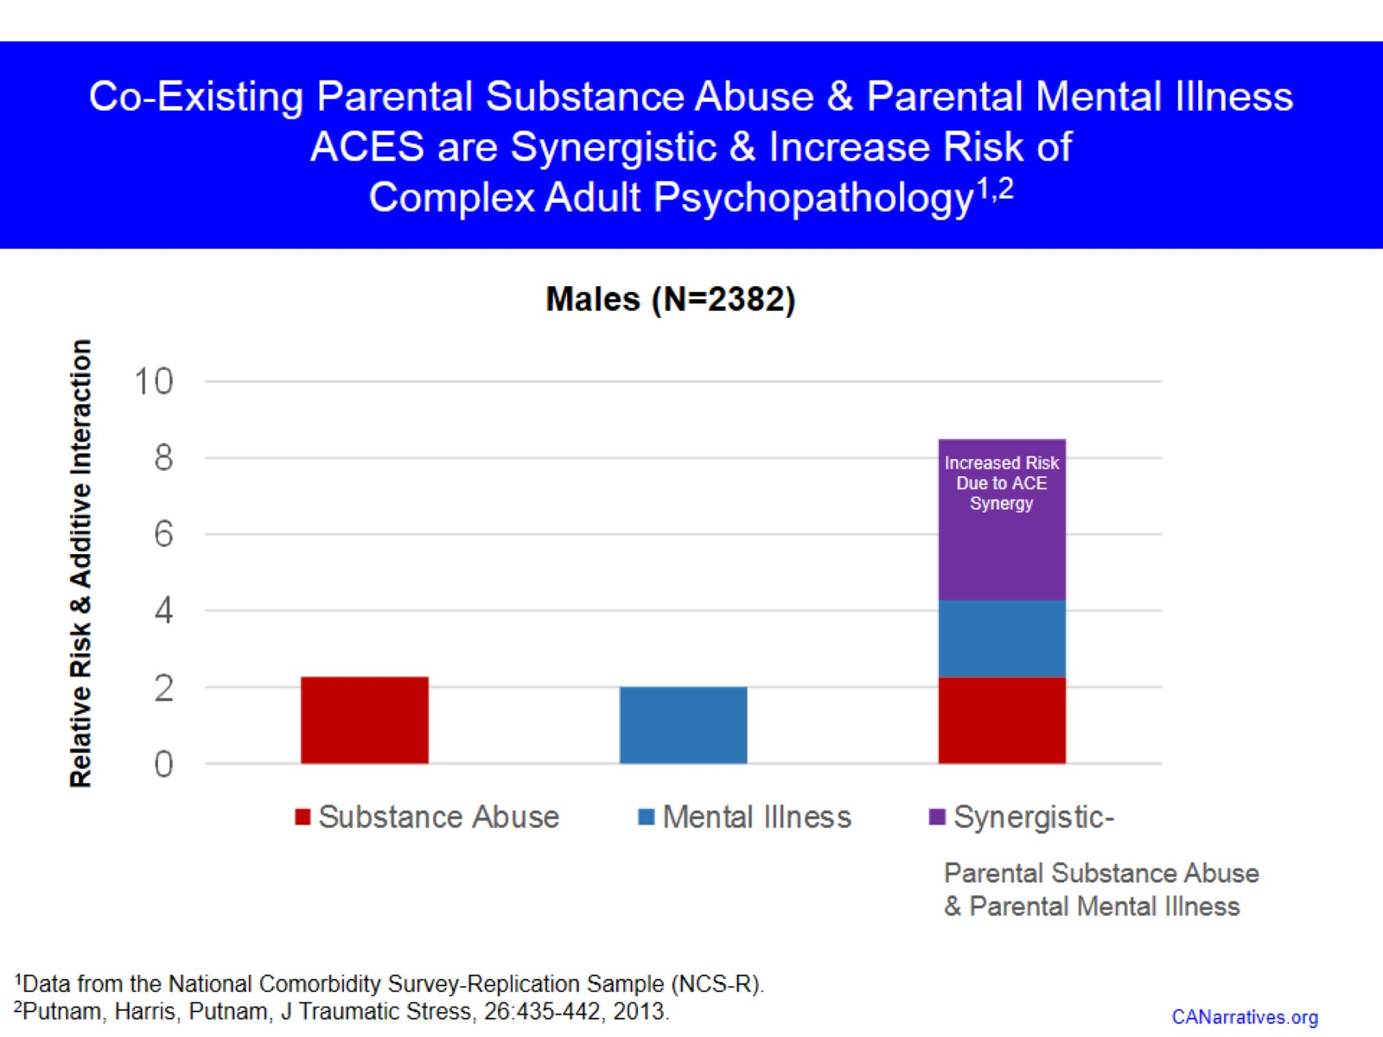
Co-Existing Parental Substance Abuse & Parental Mental Illness ACES are Synergistic & Increase Risk of Complex Adult Psychopathology^{1,2}

Slide 24
Synergistic ACES in Females ^{1,2}

Slide 25
Synergistic ACES in Males ^{1,2}

Slide 26
Synergy between ACES & Other Adversities (e.g., Environmental Pollution¹)

Slide 27
Addressing ACES Offers Critical Public Health Opportunities¹

Slide 28
Costs of Cumulative & Synergistic ACES

Slide 30
Estimated Lifetime Costs for all 2014 First Time Maltreatment Victims = $5.9 Trillion¹

Slide 32
What Do We Have Available Now?

Slide 33
Child Abuse Prevention

Slide 34
Treatment

Slide 35
The National Child Traumatic Stress Network (NCTSN) Centers and Affiliated Agencies Provide Proven Treatments to Traumatized Youth Nationwide¹

Slide 37
Prevention & Treatment Costs

Slide 38
Preventing ACES is Protective Within & Across Generations

Slide 39
Measuring Risk

Slide 42
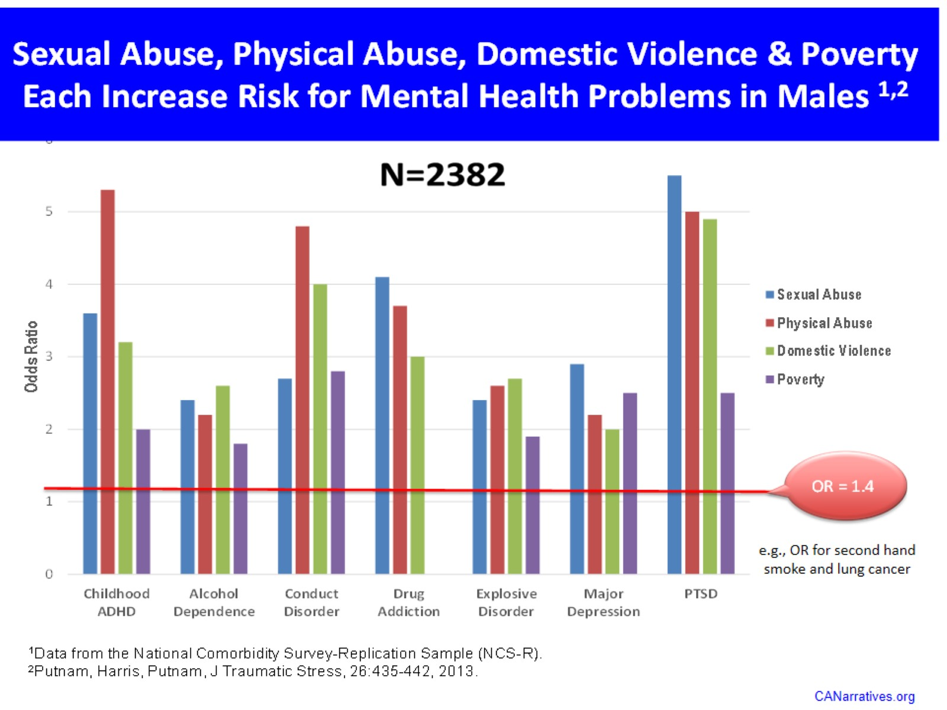

Slide 43
Prevention, Screening, & Treatment Can Be Embedded In Existing Systems That Serve Children

Slide 44
Summary

Slide 45
What More Can We Do?

Slide 46
How Would We Do It?

Slide 47
What Are The Expected Outcomes?

Slide 48
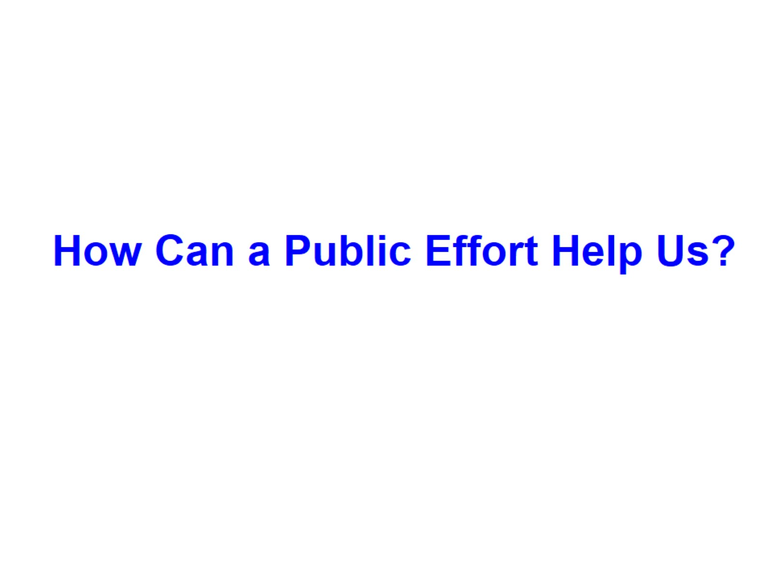
How Can a Public Effort Help Us?

Slide 49
Christof Wieland, the German man of letters, wrote in 1798 that public opinion was “ . . . an opinion that gradually takes root among a whole people; especially among those who have the most influence when they work together as a group. In this way it wins the upper hand to such an extent that one meets it everywhere… It then only requires some small opening that will allow it air, and it will break out with force. Then it can change whole nations in a brief time and give whole parts of the world a new configuration.” ¹

